Slide 1


<Abulfida Ahmed>
<14/7/2024>

Slide 2

Outline
Executive Summary
Introduction
Methodology
Results
Conclusion
Appendix

Slide 3
Executive Summary
Summary of methodologies
Summary of all results

Slide 4
Introduction
Project background and context
Problems you want to find answers

Slide 5

Section 1

Slide 6
Methodology
Executive Summary
Data collection methodology:
Describe how data was collected
Perform data wrangling
Describe how data was processed
Perform exploratory data analysis (EDA) using visualization and SQL
Perform interactive visual analytics using Folium and Plotly Dash
Perform predictive analysis using classification models
How to build, tune, evaluate classification models

Slide 7
Data Collection
Describe how data sets were collected.
Data was collected by different methods
- We make a get request to the SpaceX API to get data by using libraries requests.
- decoded the response content as a Json using .json() function call and turn it
into a pandas dataframe using .json_normalize()
- Cleaned the data and performed web scraping from Wikipedia for Falcon 9 launch records with BeautifulSoup
-The objective was to extract the launch records as HTML table, parse the table and convert it to a pandas dataframe.

Slide 8
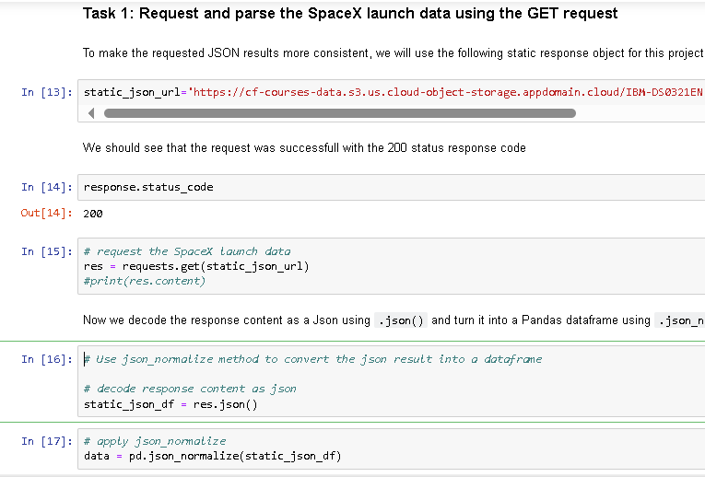
Data Collection – SpaceX API
We used the get request to the
SpaceX API to collect data, clean the requested data and did basic data wrangling and formatting.
https://github.com/nyalau-team/Captsone/blob/342ffd57c6aa4eba9894e9dd4d512500af5c7d11/Data%20Collection%20API.ipynb
Place your flowchart of SpaceX API calls here

Slide 9
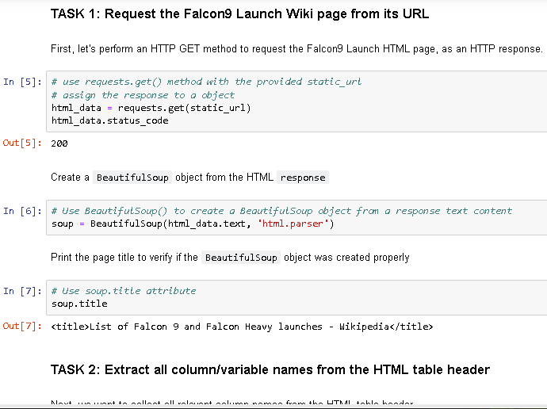
Data Collection - Scraping
*Applied web scrapping to Falcon 9 launch with BeautifulSoup
* parsed the table and converted
it into a pandas dataframe.
https://github.com/nyalau-team/Captsone/blob/342ffd57c6aa4eba9894e9dd4d512500af5c7d11/Data%20Collection%20with%20Web%20Scraping.ipynb
Place your flowchart of web scraping here

Slide 10
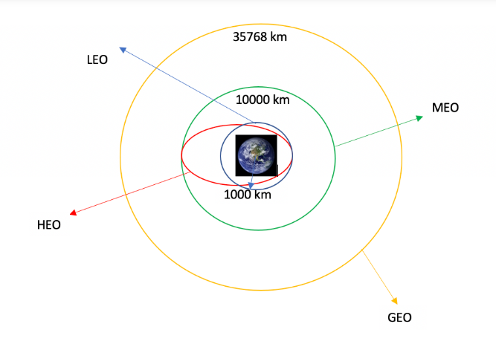
Data Wrangling
Performed exploratory data analysis
and determined the training labels
Calculated the number of launches at
each site, and the number and occurrence
of each orbits
We created landing outcome label
https://github.com/nyalau-team/Captsone/blob/342ffd57c6aa4eba9894e9dd4d512500af5c7d11/Data%20Wrangling.ipynb

Slide 11
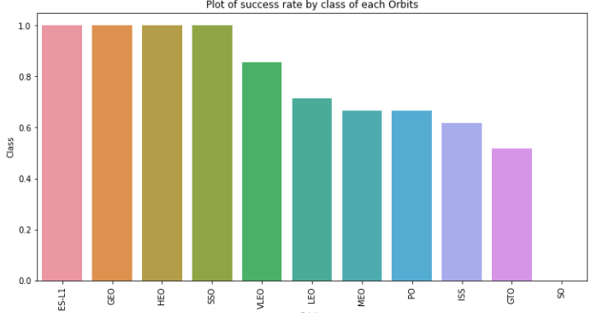
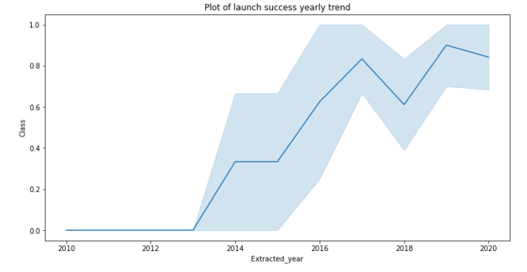
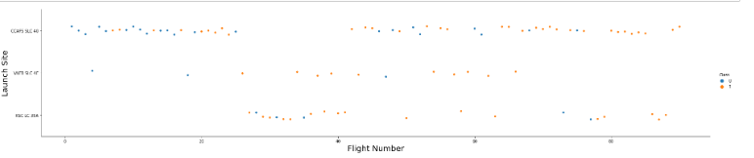
EDA with Data Visualization
explored the data by visualizing the relationship
between flight number and launch Site, payload
and launch site, success rate of each orbit type,
flight number and orbit type, the launch success
yearly trend.
https://github.com/nyalau-team/Captsone/blob/342ffd57c6aa4eba9894e9dd4d512500af5c7d11/EDA%20with%20Data%20Visualization.ipynb

Slide 12
EDA with SQL
We loaded the SpaceX dataset into a PostgreSQL database
We applied EDA with SQL to get insight from the data
The names of unique launch sites in the space mission.
- The total payload mass carried by boosters launched by NASA
- The average payload mass carried by booster version F9 v1.1
- The total number of successful and failure mission outcomes
https://github.com/nyalau-team/Captsone/blob/342ffd57c6aa4eba9894e9dd4d512500af5c7d11/EDA%20with%20SQL.ipynb

Slide 13
Build an Interactive Map with Folium
We marked all launch sites, and added map objects such as markers, circles, lines to mark the success or failure of launches for each site on the folium map
We assigned the feature launch outcomes 0 and 1
We calculated the distances between a launch site to its proximities.
https://github.com/nyalau-team/Captsone/blob/342ffd57c6aa4eba9894e9dd4d512500af5c7d11/Interactive%20Visual%20Analytics%20with%20Folium.ipynb

Slide 14
Build a Dashboard with Plotly Dash
We built an interactive dashboard with Plotly dash
We plotted pie charts showing the total launches by a certain sites
We plotted scatter graph showing the relationship with Outcome and Payload
Mass (Kg) for the different booster version
https://github.com/nyalau-team/Captsone/blob/342ffd57c6aa4eba9894e9dd4d512500af5c7d11/Extracting%20and%20Visualizing%20Stock%20Data.ipynb

Slide 15
Predictive Analysis (Classification)
We loaded the data using numpy and pandas, transformed the data, split our data into training and testing
Built different machine learning models
We found the best performing classification model
https://github.com/nyalau-team/Captsone/blob/342ffd57c6aa4eba9894e9dd4d512500af5c7d11/Extracting%20and%20Visualizing%20Stock%20Data.ipynb

Slide 16
Results
Exploratory data analysis results
Interactive analytics demo in screenshots
Predictive analysis results

Slide 17

Section 2

Slide 18
Flight Number vs. Launch Site
From the plot, we found that the larger the flight amount at a launch site, the greater the success rate at a launch site.

Slide 19
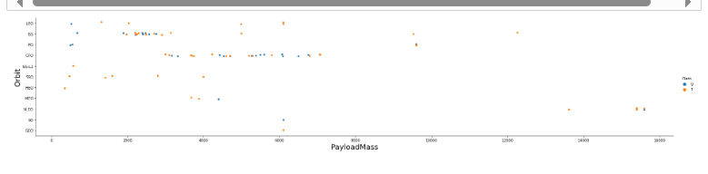
Payload vs. Launch Site
CCFAS SLC 40 is highest success rate

Slide 20
Success Rate vs. Orbit Type
From the plot, we can see that ES-L1, GEO, HEO, SSO, VLEO had the most success rate

Slide 21
Flight Number vs. Orbit Type
Flight number vs. Orbit type

Slide 22
Payload vs. Orbit Type
Show a scatter point of payload vs. orbit type
Show the screenshot of the scatter plot with explanations

Slide 23
Launch Success Yearly Trend
Show a line chart of yearly average success rate
Show the screenshot of the scatter plot with explanations

Slide 24
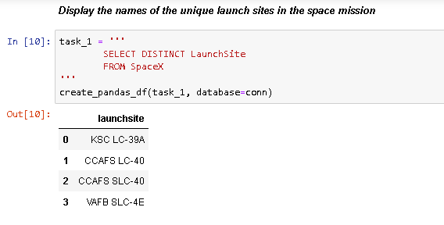
All Launch Site Names
The unique launch sites

Slide 25
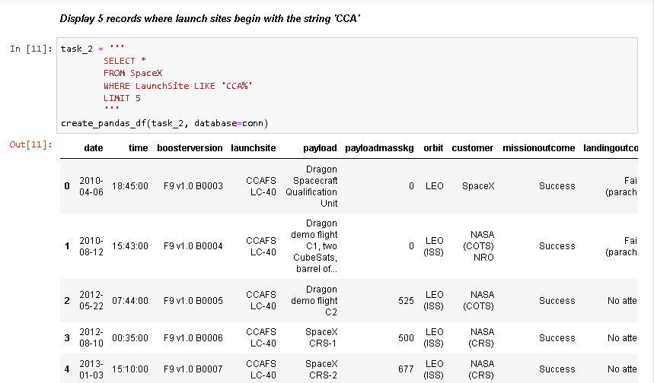
Launch Site Names Begin with 'CCA'
5 records where launch sites begin with `CCA`

Slide 26
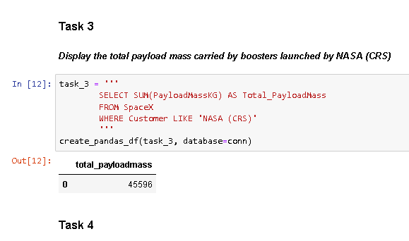
Total Payload Mass
Calculate the total payload carried by boosters from NASA

Slide 27
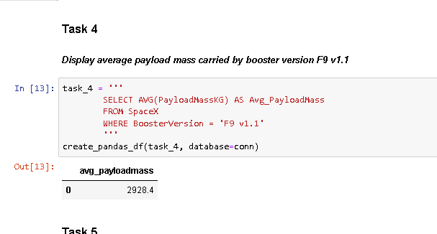
Average Payload Mass by F9 v1.1
Calculate the average payload mass carried by booster version F9 v1.1
Present your query result with a short explanation here

Slide 28
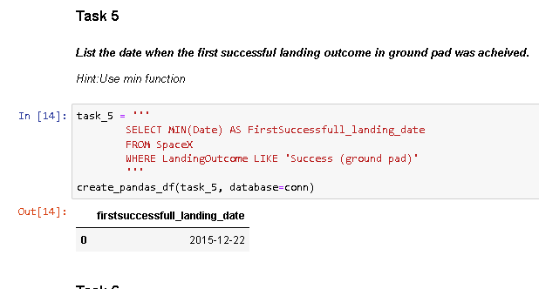
First Successful Ground Landing Date
the dates of the first successful landing outcome on ground pad
Present your query result with a short explanation here

Slide 29
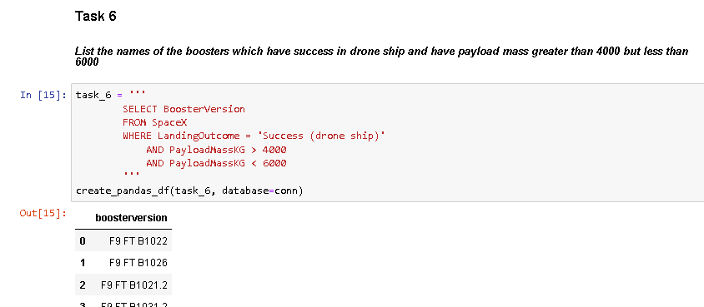
Successful Drone Ship Landing with Payload between 4000 and 6000
the names of boosters which have successfully landed on drone ship and had payload mass greater than 4000 but less than 6000
Present your query result with a short explanation here

Slide 30
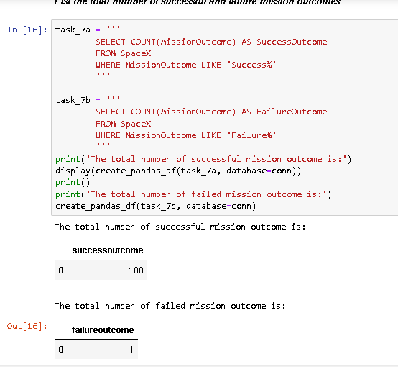
Total Number of Successful and Failure Mission Outcomes
the total number of successful and failure mission outcomes
Present your query result with a short explanation here

Slide 31
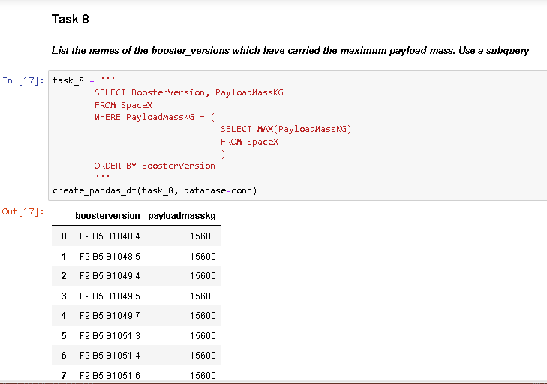
Boosters Carried Maximum Payload
List the names of the booster which have carried the maximum payload mass
Present your query result with a short explanation here

Slide 32
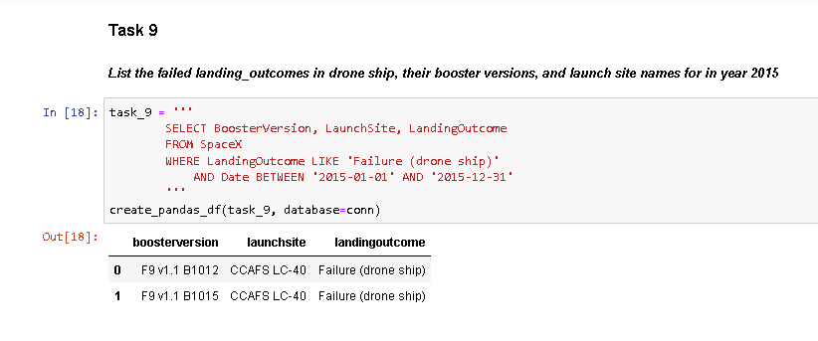
2015 Launch Records
List the failed landing_outcomes in drone ship, their booster versions, and launch site names for in year 2015
Present your query result with a short explanation here

Slide 33
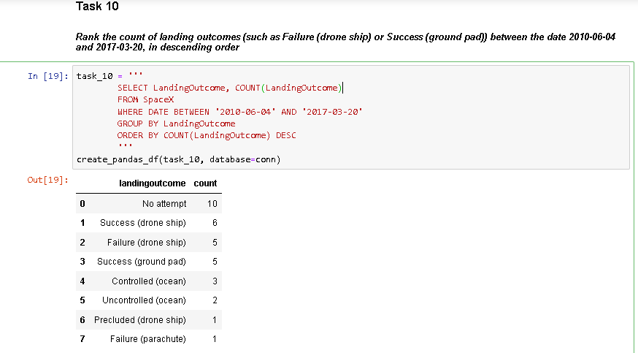
Rank Landing Outcomes Between 2010-06-04 and 2017-03-20
Rank the count of landing outcomes (such as Failure (drone ship) or Success (ground pad)) between the date 2010-06-04 and 2017-03-20, in descending order
Present your query result with a short explanation here

Slide 34

Section 3

Slide 35
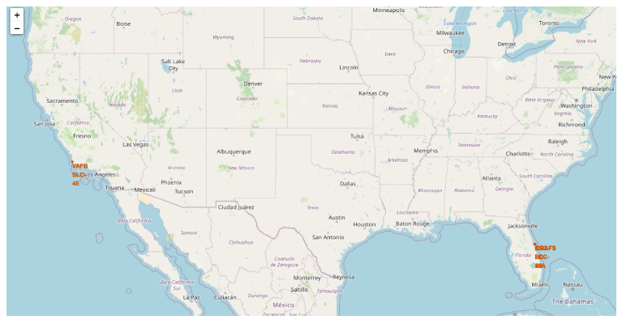
<Folium Map Screenshot 1>
Explore the generated folium map and make a proper screenshot to include all launch sites’ location markers on a global map
Explain the important elements and findings on the screenshot
<All launch sites global map markers >

Slide 36
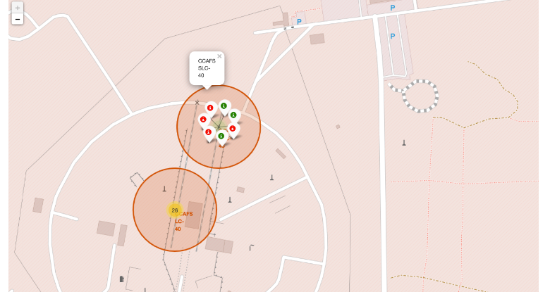
<Folium Map Screenshot 2>
Markers showing launch sites with color labels
Explore the folium map and make a proper screenshot to show the color-labeled launch outcomes on the map
Explain the important elements and findings on the screenshot

Slide 37
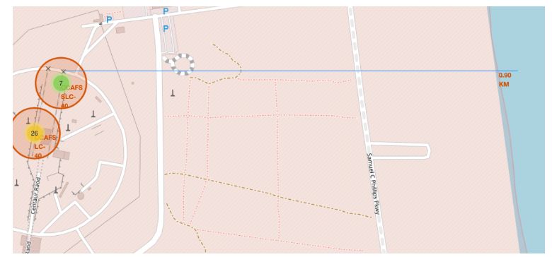
<Folium Map Screenshot 3>
Launch Site distance to landmarks
Explore the generated folium map and show the screenshot of a selected launch site to its proximities such as railway, highway, coastline, with distance calculated and displayed
Explain the important elements and findings on the screenshot

Slide 38

Section 4

Slide 39

<Dashboard Screenshot 1>
Pie chart shows the success poropbtion achieved by each launch site
Show the screenshot of launch success count for all sites, in a piechart
Explain the important elements and findings on the screenshot

Slide 40

<Dashboard Screenshot 2>
Pie chart illustrates the Launch site with the highest launch success ratio
Show the screenshot of the piechart for the launch site with highest launch success ratio
Explain the important elements and findings on the screenshot

Slide 41

<Dashboard Screenshot 3>
Scatter plot of Payload vs Launch Outcome for all sites, with different payload selected in the range slider
Show screenshots of Payload vs. Launch Outcome scatter plot for all sites, with different payload selected in the range slider
Explain the important elements and findings on the screenshot, such as which payload range or booster version have the largest success rate, etc.

Slide 42

Section 5

Slide 43
Classification Accuracy
The decision tree classifier is the model with the highest classification accuracy
Find which model has the highest classification accuracy

Slide 44

Confusion Matrix
The confusion matrix for the decision tree classifier shows that the classifier can distinguish between the different classes. The major problem is the false positives .i.e., unsuccessful landing marked as successful landing by the classifier

Slide 45
Conclusions
The larger the flight amount at a launch site, the greater the success rate at a launch site.
Launch success rate started to increase in 2013 till 2020.
Orbits ES-L1, GEO, HEO, SSO, VLEO had the most success rate.
KSC LC-39A had the most successful launches of any sites.
The Decision tree classifier is the best machine learning algorithm for this task.

Slide 46
Appendix
Include any relevant assets like Python code snippets, SQL queries, charts, Notebook outputs, or data sets that you may have created during this project

Slide 47


